Slide 1

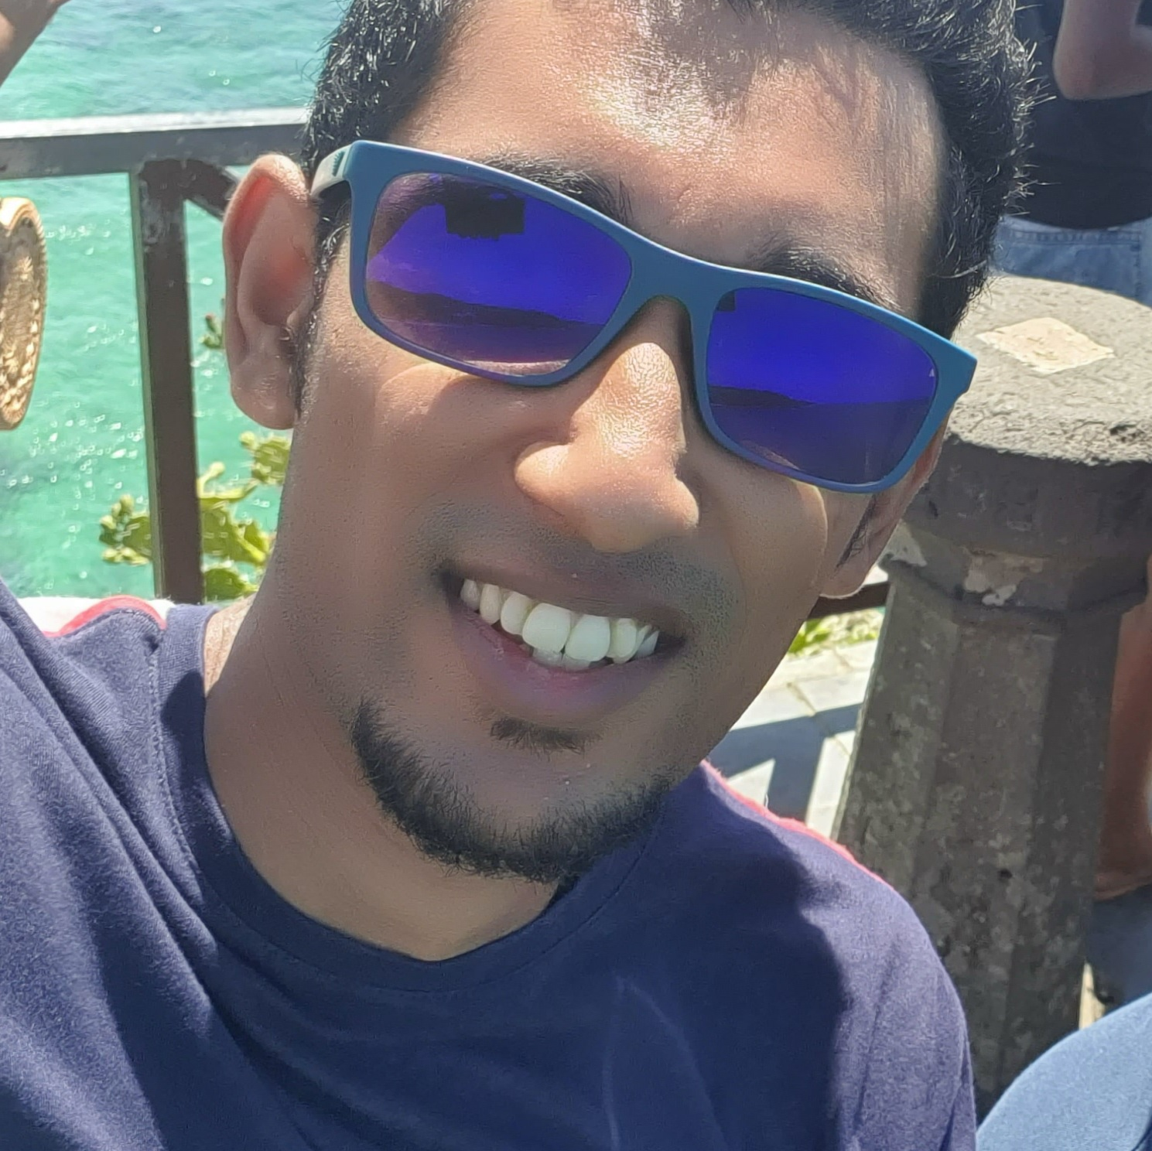

Experience
Areas of expertise
Functional
Software engineering
Analytics
Agile
UX / UI
Data warehousing
Industries
Banking
Energy
Technical
Azure DevOps
Dax
SQL(SSMS)
Data Model
Power BI
Power Apps
ETL
MDX
Powerapps
SSRS(report builder)
CHANEL ( Mar 2021 - Present)
BI & Power App Developer
Use of Powerapps, PowerBi and Report builder to meet client needs
SCHLUMBERGER ( Mar 2020 – Mar 2021)
BI Developer
Power BI reporting using database from Azure data warehouse
Report Building using Power BI
App development using Power Apps integrated in power BI
VINCI ( Sep 2020– Feb 2020)
BI Developer
Reporting
ETL
Lilesh Dev JOYMUNGUL
Data Engineer
Application Development Analyst Ebène, Mauritius.
Education
MSc Applied Software Technologies
University of Mauritius, 2020
BSc(Hons) Management (minor : Finance)
University of Mauritius, 2018
Professional Qualification
London College of Accountancy, ACCA Level 1 2015
Certifications
1. AZ-900(2020)
2. DP-900(2021)
3. PL-300(2022)
4. PL-900(2023-planned)
Professional background
BI Developer with 2+ year experience in ETL and reporting
Aspiration
Data Science

Slide 2

Past Experience
Data Engineer Schlumberger (Mar 2020 - 2021 )
Skills & Technologies
Skills
Teamwork
Client facing
Analysis & solutions design
Scrum
Problem Solving
Technical
Azure DevOps
SQL Server Management Studio
Visual Studio
Power Apps
Power BI
I am responsible for the following project activities:
Collaborating with the stakeholders to fully understand the requirements and making sure that the features fulfill the business needs.
Working with different teams (functional and technical) to come with the proper approach to tackle various design and implementation problems.
Enforcing the Agile principles though SCRUM methodology(daily meetings across , sprint planning ,sprint backlog follow-ups).
Regular demos to the business for the features implemented.
Currently working with the team to deliver several modules for the business to use for reporting and analysis.

Slide 3
Past Experience
BI Developer Sep 2019 – Oct 2020
Performing ETL on project using Power BI
Report Building using Power BI
Customer Refresh (KYC) for Barclays Nov 2018 – Mar 2019
Background checking and analysis of clients.
Inventory Management of client's information.
Customer Complaints administrator for CWA June 2017 – Nov 2017
Complaints management(Port Louis Region).

